Slide 1
How to Clean Up Your Inventory Data and Keep It That Way
Kevin Herrick
kherrick@apslearns.org
Notes:
Welcome
Promote discussion

Slide 2

About our District
3500 Full Time Employees
21000 Students
71000 Devices currently in our asset management system
48 buildings (30 Elementary, 5 Middle, 8 High School, 1 Auxiliary, 4 Administration)

Slide 3
Staff with roles in Inventory Management
Property Management - 3 people - District Level
Desktop Support - 8 people - District Level
Help Desk - 2 people - District Level
Technology Support Specialists (TSS) - 22 people - School based - Each of them are responsible for 1-3 school buildings. They are still a part of IT.
Notes:
Property Mgmt - Not IT
Everyone else is a member of IT

Slide 4
Where we started. MUNIS Fixed Assets
Only Property Management had access to the system. IT had limited access to reports and no access to change the data.
No purchase controls.
Equipment could be assigned to a building and a room only.
There were no TSS members.
All inventory requests were done with paper sent downtown through the district mail system.
Notes:
Purchase Controls - Schools could order what they want and ship it to wherever they want.
Could not be assigned to users. Hard to go 1:1 if you cannot assign a device to a student.
NO - TSS - Someone other than IT was responsible for sending in the form to the district.
Sample IF-1 Form - Some forms took months to process.

Slide 5
The beginning of change - Still before 1:1
Technology Support Specialists were hired to the district.
IT needs access to IT inventory
TSS responsible to keep a building inventory
The decision was made to use Google Sheets to track inventory.
District master spreadsheet was linked to the site inventories.
Notes:
22 of them.
IT access to inventory - Seems pretty logical.
IT determines they need to begin tracking IT assets at the building level so we can have a better idea of what is actually at each school.
While this was better than nothing it was quickly out of date if local inventories were not updated. They weren’t!

Slide 6

New System (TIPWeb-IT) and 1:1 Initiative
District announced their plan to complete 1:1 rollout of Chromebooks in a 2.5 year period.
District issued a RFI for new Asset Management system for technology and for textbooks.
We selected TIPWeb-IT and TIPWeb-IM from Hayes Software
We temporarily used library system (workflows) to issue Chromebooks to students until new system was rolled out which took about six months.
Notes:
RFI - New system had to include the ability to assign devices to people as well as locations.

Slide 7
Importing data into the new system
Gather export files from all the sources
Merge the 3 files together.
Left us with a file with over 100000 devices.
The most important suggestion from everyone we talked to was spend the time cleaning your import file before importing.
Notes:
MUNIS - Export all IT related items to a spreadsheet.
We found that all of our chromebooks were not in MUNIS. We were missing thousands of them. But they were all in workflows. So we exported all Chromebooks from Workflows
Google Sheets school inventories

Slide 8
Cleaning the import data.
Took me a little over a week to do.
Clean up duplicate serial numbers.
Remove the items we did not want to track with the new system
Expanded product types.
Notes:
Took me a little over a week to do. Full time, doing nothing else.
With equipment coming from multiple systems, we had lots of duplicates.
Remove the items we did not want to track with the new system including items that could not possibly still be in the district. Powermacs, Gateway 486 desktops, etc. Items bought before Y2K.
Expand product types - Our old system had a limited number of product types. We added product types for Document cameras, Interactive Whiteboards, Tablets, Chromebooks, etc.

Slide 9
Cleanup continues…..
Cleaned up manufacturers.
Product names
Model numbers
Site information
Once completed we were down from over 100000 to 45,388 items to import.
Notes:
Combining HP, Hewlett Packard, Hewlett-Packard etc into one manufacturer. Apple, Apple INC, Apple Computers, etc…..
Product Names - 5800 Desktop, dc5800, 5800 workstation, HP5800, etc
Sites - Equipment existing in buildings that we closed years ago.

Slide 10
Setting up TipWeb and importing the data
Sites were created in TIPWeb.
Room Setup
Setup nightly import of users from our SIS/ERP systems.
Import purchase orders that arrived after the import file was processed
Purchased Asset tags and scanners for IT staff.
Opened the new system for use
Notes:
Sites - As the data was imported, if the listed site didn’t exist, the device was created in a holding site to be sorted later.
Rooms If the device had a room, that room was also created as part of the import. We then create the additional rooms using floor plans that were missing after import.
Closed the new system a few days later when Property Mgmt moved all the assets to one site.

Slide 11
Adding assets to the system - New Items
New rule - All technology purchase orders route through IT for approval.
New rule - All Technology items are delivered to the warehouse.
Items are moved to the buildings (Site to Site Transfer) and are put in a virtual room called receiving.
When the equipment arrives at the school, TSS transfers from receiving room to it’s actual location (Room to Room Transfer).
Notes:
New rule - All technology purchase orders route through IT for approval. We now know what is coming and can enforce equipment standards.
New rule - All Technology items are delivered to the warehouse. No more delivery to the schools. This ensures all items are imported into TipWeb.

Slide 12
Adding found items
TSS members cannot add items to inventory.
They create a ticket to create new items.
Expect a heavy workload in the beginning
Notes:
They were not thorough enough to search for like serial numbers that may have typos or serial numbers that had combined model numbers.
In the beginning we received entire spreadsheets of equipment to add from buildings. After about 6 months the steady flow stopped. Now I create new “found” assets maybe once or twice a month.

Slide 13
Moving equipment around - Transfer types
Room to Room (All Users)
Assign to users (All Users)
Site to Site (District Only)
Notes:
Room to Room This is within the same site. The TSS members have full rights to move equipment within their sites.
Assign to users - The TSS can assign devices to users assuming the device and the user are both in the same location and the TSS has access to that location. TSS members can create Staff members but not Students.
Site to Site - Only district personnel can move items between sites. The TSS needs to put in a ticket to have a device moved to another sites. We wanted district control over equipment moving between buildings. Student devices are the exception as they follow the student automatically through the nightly import.

Slide 14
Ways to remove an Item from inventory
Put in a request to have items retired that you have but no longer want
File a police report for lost/stolen items
Property Management Audit.

Slide 15
Removing Devices Procedure - Retired
TSS marks items for disposal in TipWeb, runs the report and send downtown in a support ticket.
IT processes the ticket
Buildings and Grounds department schedules pickup.
Equipment is transferred out of the building only when it is physically removed.
Notes:
IT divides the assets into Recycle, Buy Back, and Reuse.
Property Mgmt handles removing recycled assets
IT manages Buy Back and Repurposed devices.
Equipment is transferred out of the building only when it is physically removed.

Slide 16
Removing Devices Procedure - Lost/Stolen
TSS marks device as Lost/Stolen.
TSS submits report of Lost/Stolen for a police report.
A ticket is sent for IT to process the police report.
IT processes the police report removing items that have not been found
Notes:
TSS marks device as Lost/Stolen in Tipweb. Chromebooks are also locked (Disabled) in the google console.
Still has a Lost/Stolen status). If it is available or back in use it is not retired as it has been found/turned back in. With Chromebooks we also use the google Admin Console to determine if the device has been found.

Slide 17
Retire Devices - Audit
The last way devices can be removed is through an audit.
Audits are conducted by Property Management only.
After they conduct the audit they will remove certain items from inventory.

Slide 18
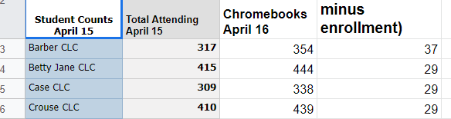
Procedures/Guidelines for keeping it clean
TIPWeb is the rule of law.
Notes:
TIPWeb inventory is the only inventory that the district uses. Schools cannot request additional equipment if their TIPWeb numbers do not support it. An example of this is student Chromebooks. Each school is given an allotment of spare devices (30-60). We use their tipweb numbers against enrollment numbers. Devices count in the schools inventory even if they are lost/stolen/broken. This forces police reports and requires them to turn their repairs in for service on a regular basis. The spare number has increased as we found (20-45) spares were not enough for our system. It can be tweaked if needed.

Slide 19
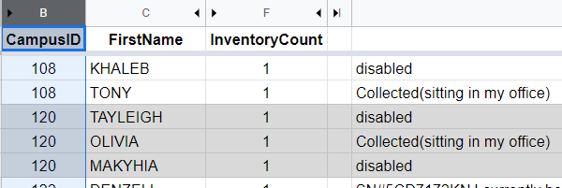
Procedures/Guidelines for keeping it clean
Inactive Student Report
Notes:
Inactive Student report. Every night I get a report of students that would have been marked inactive but still have devices assigned to them. Every couple of weeks this is sent to the TSS to they can clean these up. Many times the Chromebook was turned in but not collected in the system. Sometimes this kicks off the police report process.

Slide 20
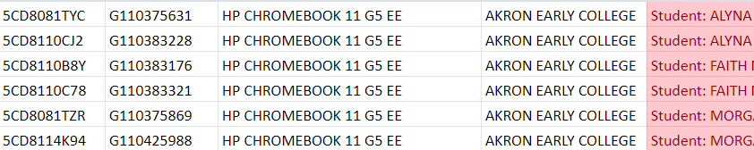
Procedures/Guidelines for keeping it clean
Students with Multiple Devices Report
Notes:
Students with multiple devices. This report is run every couple of weeks as well. Sometimes students transfer and receive a new Chromebook at the new school and still have their old one. Allows schools to clean this up. I actually run a tipweb report through Excel for this one for conditional formatting

Slide 21
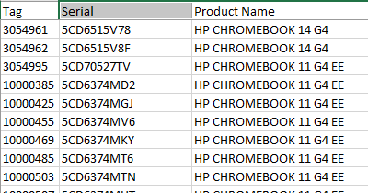
Procedures/Guidelines for keeping it clean
The new asset tags are different than the old system.
Notes:
The new asset tags are different than the old system. Everything we touched was retagged. Items with the old tags are items were part of the import but have not been touched in the district since.
Sample of how new tags start with 1 instead of 2 or 3.

Slide 22
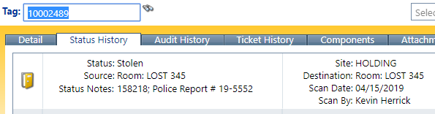
Procedures/Guidelines for keeping it clean
All Site to Site transfer requests must be done in a ticket.
Notes:
All Site to Site transfer requests must be done in a ticket and that ticket number is recorded in the Status history for our record of why it was moved.

Slide 23
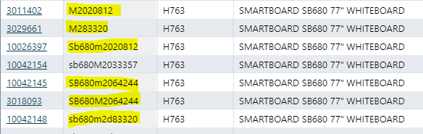
Procedures/Guidelines for keeping it clean
Asset Creation Control
Notes:
Asset creation is done at the district level to prevent adding duplicate devices to inventory. Otherwise, if they wanted to assign an asset that was from another site, they could just create a new asset at their site with a different tag number.

Slide 24
Procedures/Guidelines for keeping it clean
All Retired/Lost/Stolen assets are moved to a site only accessible by district staff.
Purchasing Requirements
Everything is delivered to the warehouse
Notes:
If the school finds them we know because we move them back. This gives us true lost/stolen numbers.
IT approval of PO’s allows us to verify/change this.
This allows property management to ensure all new devices are on inventory

Slide 25
Questions

